Slide 1
Generating Electron Donor-Acceptor Library
March, 2019
Combining cluster detection with RNN
QI YUAN

Slide 2
Outline
Designing Donor-Acceptor Polymers
‘Experimental’ database analysis
Recurrent Neural Network (RNN) for molecular discovery
Cluster detection and transfer learning
Results and discussion

Slide 3
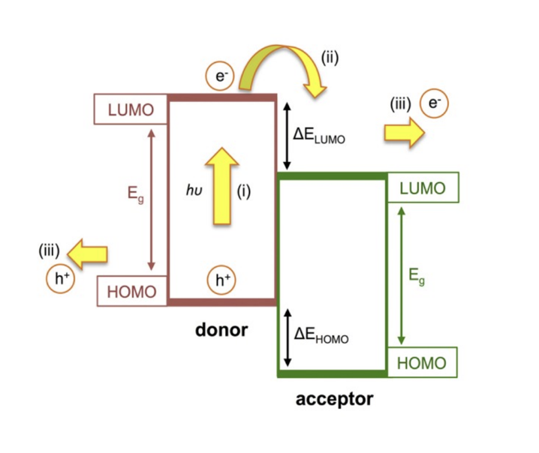
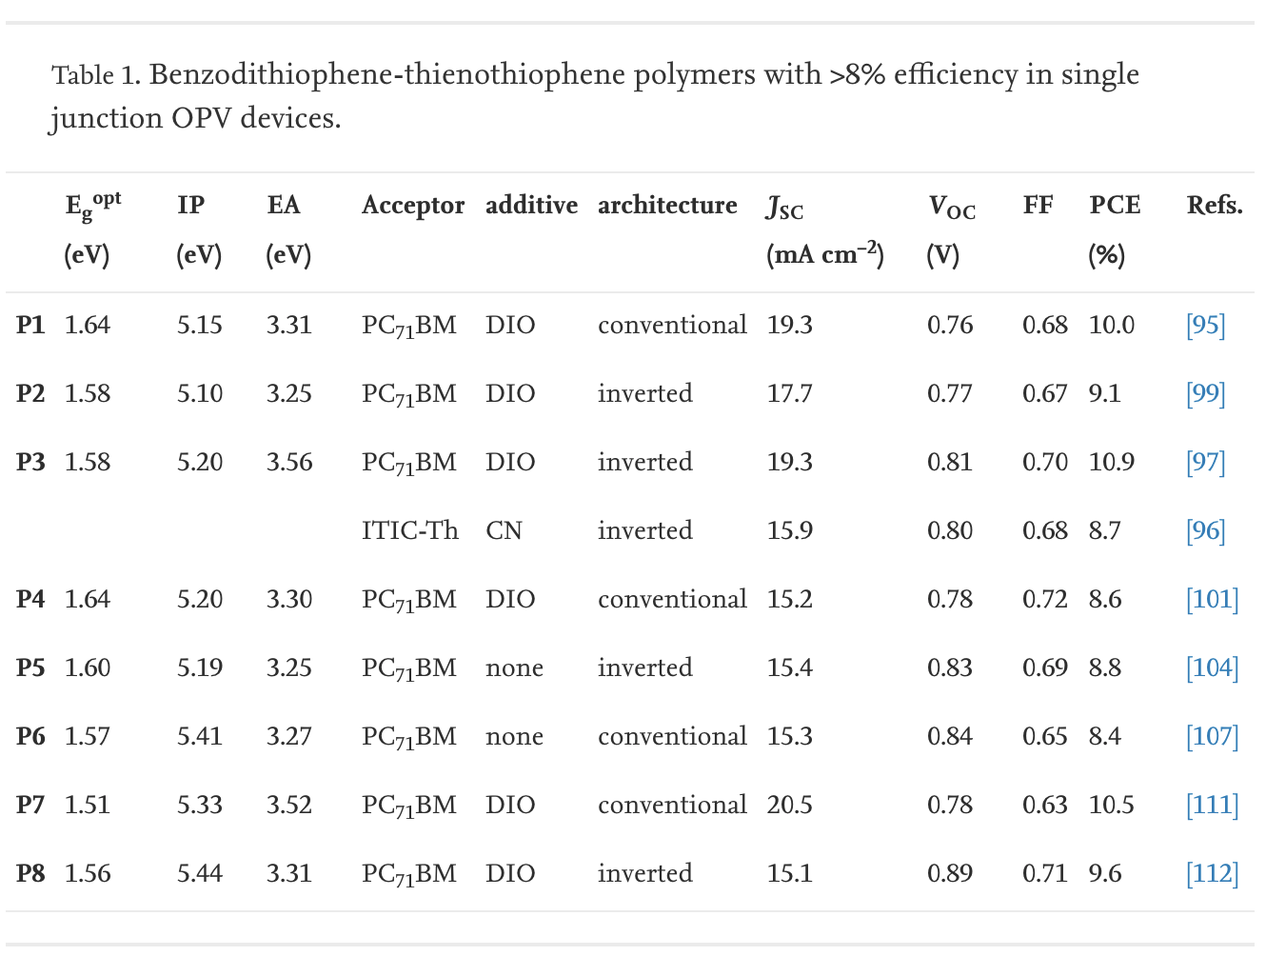
Designing Donor-Acceptor Polymers
https://doi.org/10.1016/j.progpolymsci.2017.03.003

Slide 4
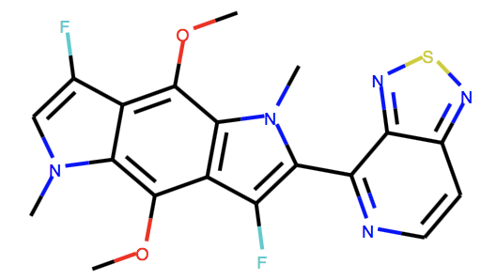
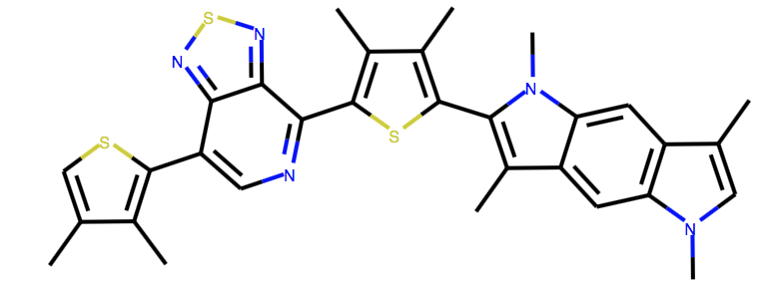
‘Experimental’ database analysis
Aim of project: Generate novel ‘promising’ molecules for D-A polymer design
Computational Materials Repository https://cmr.fysik.dtu.dk/solar/solar.html#id1

Slide 5
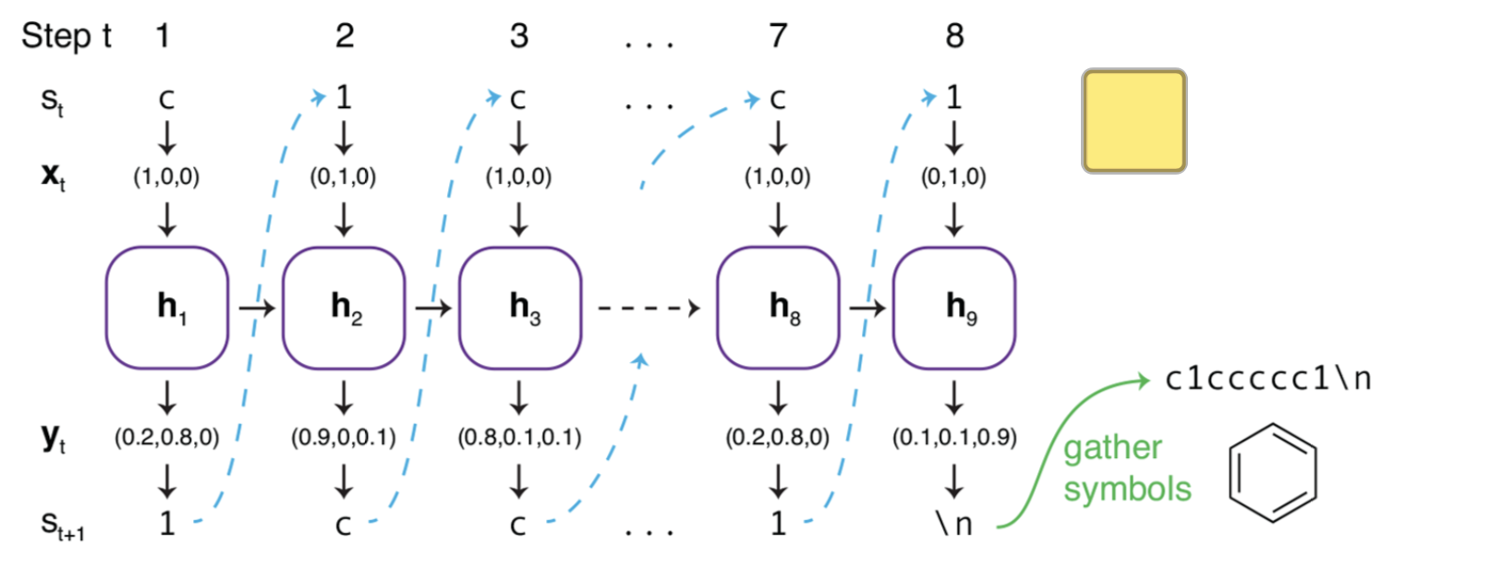

RNN for molecular discovery
SMILE representation of molecules has long-range dependence
ACS Cent. Sci. 2018, 4, 120-131
ACS Cent. Sci. 2018, 4, 120-131
ACS Cent. Sci. 2018, 4, 120-131

Slide 6
Transfer learning for ‘small’ dataset
Source labels
Target labels
Transfer learned ‘knowledge’
Source model
Target model
Target data
e.g. Functional molecules
Source data
e.g. ChEMBL

Slide 7
Clustering the unbalanced dataset
Fingerprint Calculation
Morgan FP (size =1024, radius=2)
Pairwise similarity
Tanimoto similarity
Cluster detection
Louvain method
Input Database
Detect structural-property relationship
https://github.com/taynaud/python-louvain

Slide 8
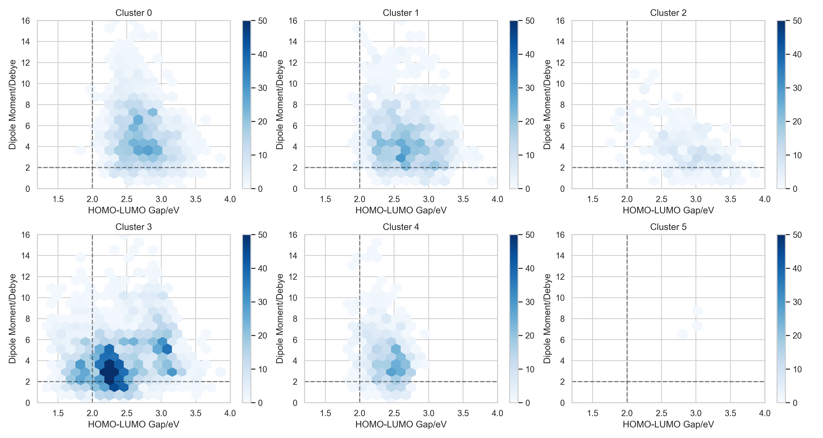
Clustering the unbalanced dataset

Slide 9
Clustering the unbalanced dataset
70/73 ‘promising’ molecules

Slide 10
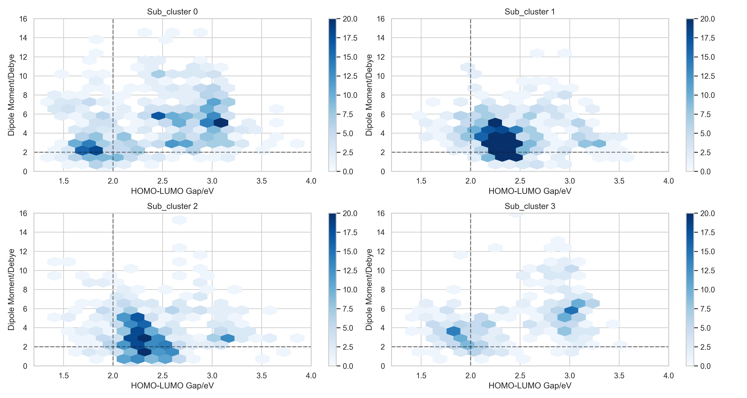
Clustering within Cluster 3

Slide 11
Clustering within Cluster 3
53/70 ‘promising’ molecules

Slide 12
Transfer learning models
Embedding (128x78)
Prior Model: 1.2m SMILES from ChEMBL
Model 1: All molecules in database
Model 2: Molecules in Cluster 3
Model 3: Molecules in Sub cluster 0
GRU layer 1 (512x128)
GRU layer 2 (521x512)
GRU layer 3 (512x512)
Linear-Softmax
arXiv: 1704.07555

Slide 13
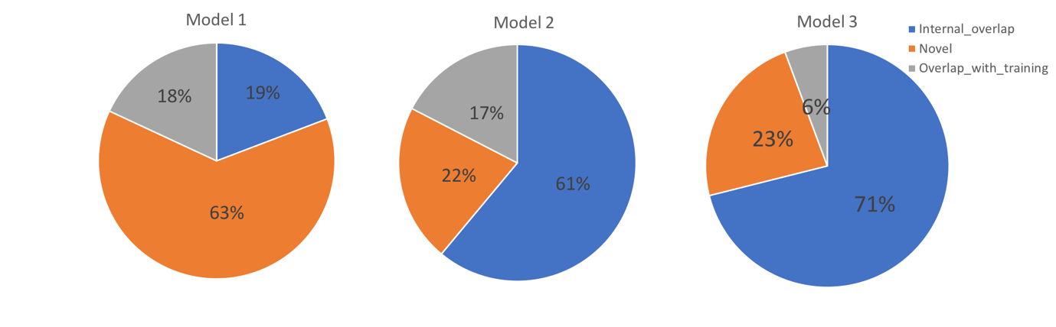
Accessing the Models: Validity, Uniqueness, Novelty
Model | Training Size | % Valid (to generate 10000 valid)
Model 1 | 5153 | 53
Model 2 | 2184 | 76
Model 3 | 668 | 71
Uniqueness and novelty in 10000 valid samples:
arXiv:1811.09621

Slide 14
Evaluation of generating ‘promising’ molecules
Gradient Boosted Decision Tree (GBDT) to predict Egap and dipole moment
GBDT
GBDT
MAE < 0.01 eV
MAE ~ 1.1 Debye
Exp
Exp
Generated molecule with Egap <= 2.0 eV, Dipole moment <= 3.6 Debye are ‘promising’

Slide 15
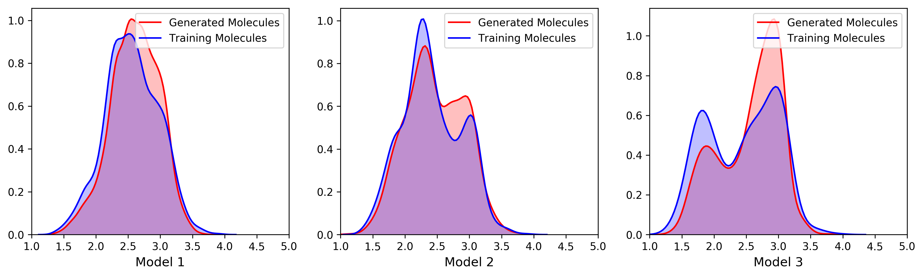
Evaluation of generating ‘promising’ molecules
Distribution of Egap values measured in eV

Slide 16
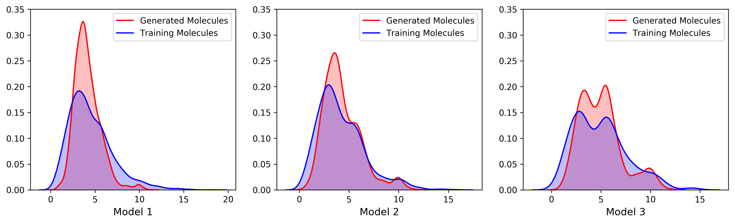
Evaluation of generating ‘promising’ molecules
Distribution of Dipole moment values measured in Debye

Slide 17
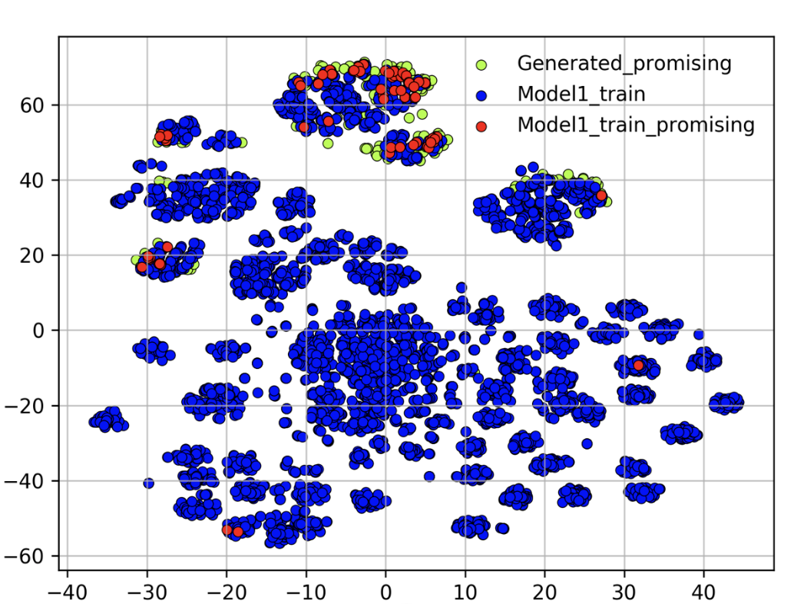
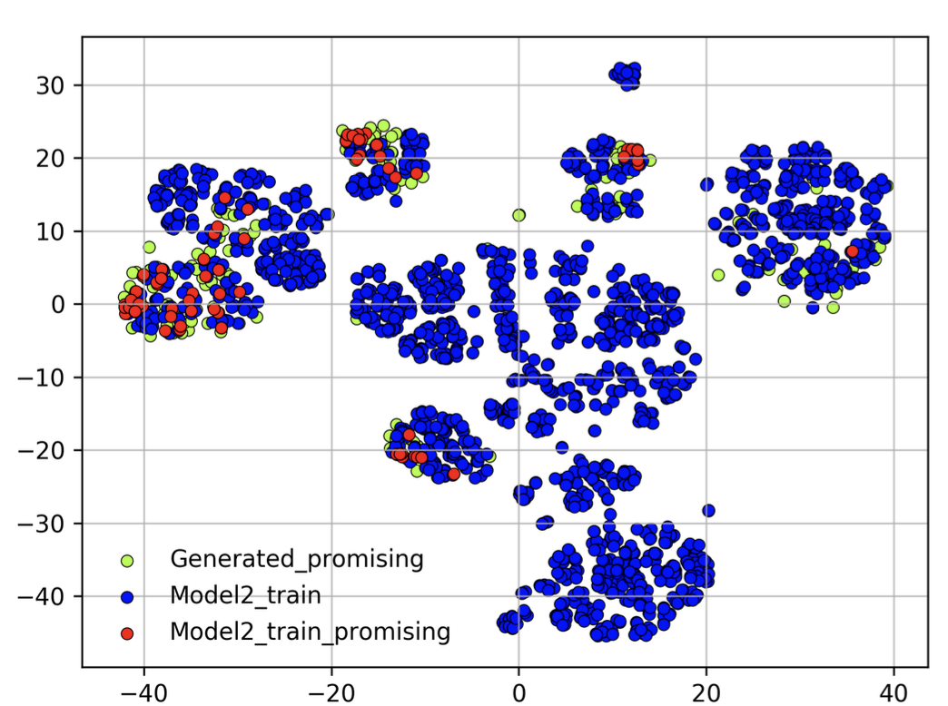
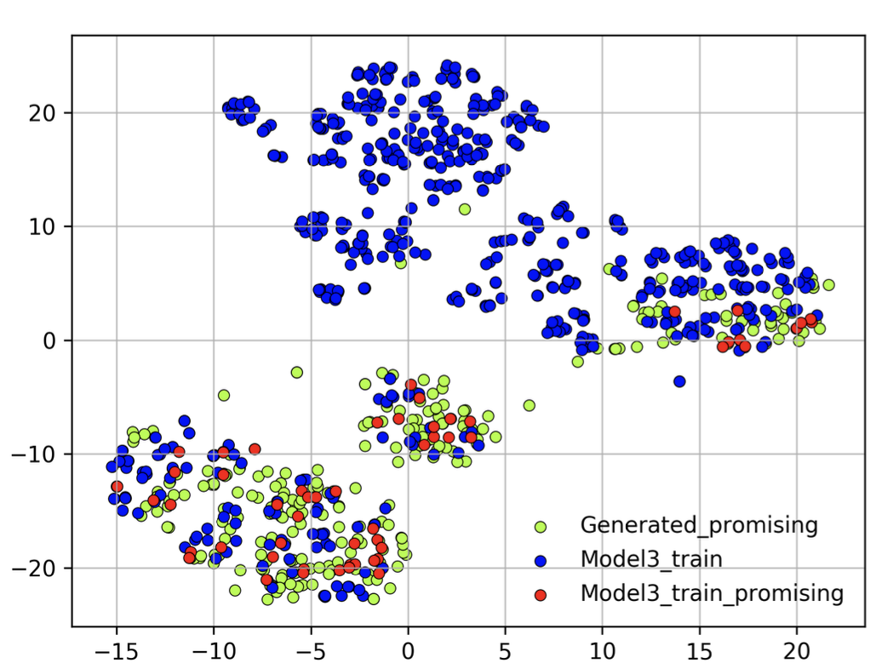
Structure-Property Relationship
‘Promising’ molecules generated:
Model 1: 217
Model 2: 182
Model 3: 273
T-SNE plots of molecular fingerprints

Slide 18
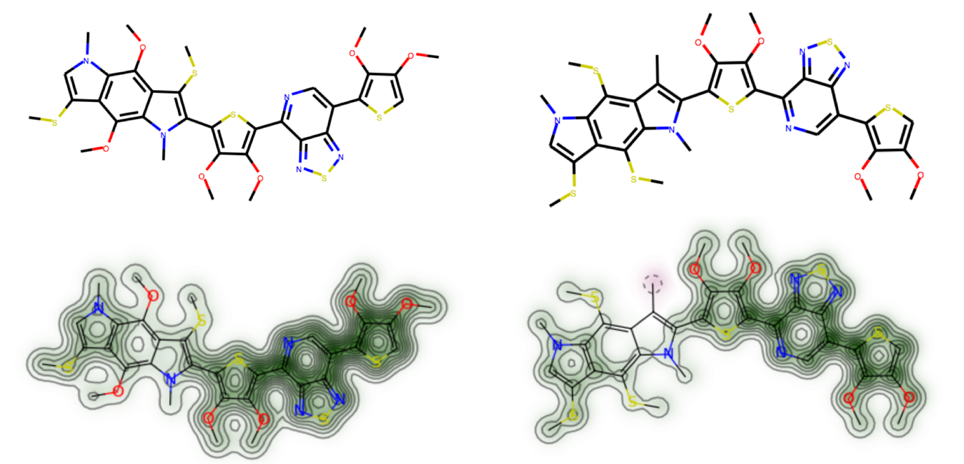
Structure-Property Relationship
‘Promising’ molecule in training DB
‘Promising’ molecule from Transfer learning

Slide 19
Conclusion & next steps
Conclusion:
‘Transfer’ from pharmaceutical DB to other organic DB is applicable
Unsupervised clustering can help tuning the available DB
Large DB reduces internal overlap, but small-tuned DB can be more ’promising’
Next steps:
Validation of generated molecules using higher level of theory
Experimental validation
Enumeration vs RNN ?

Slide 20
Bonus
GBDT
GBDT
Exp
Exp
MAE of both E_HOMO and E_LUMO are smaller than 0.1 eV

Slide 21
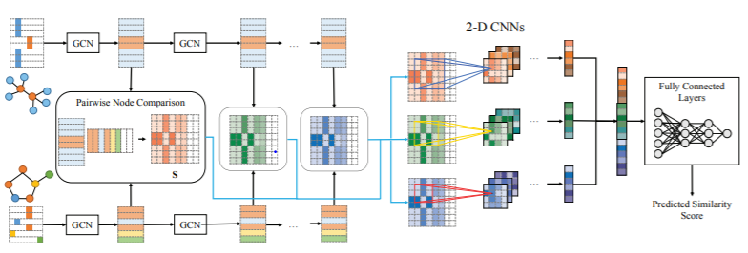
Beyond SMILES: Graph CNNs for crystals
arXiv:1808.05689

Slide 22
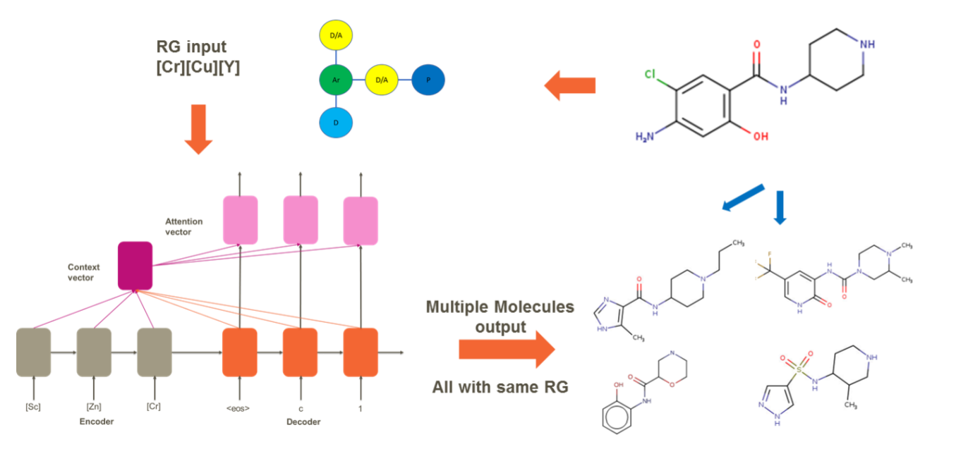
Beyond SMILES: Reduced Graphs
J. Chem. Inf. Model., 2019, 59 (3), pp 1136–1146

Slide 23
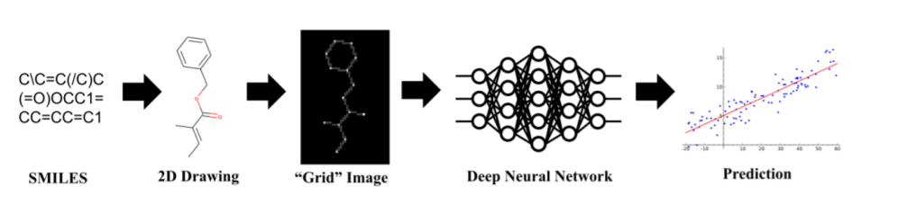
Beyond SMILES: Image representation
Predicting synthetic accessibility?
arXiv:1706.06689

